Slide 1
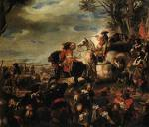
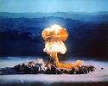
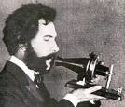
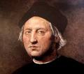
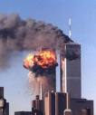
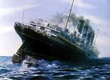
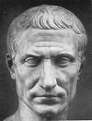
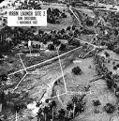
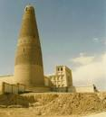
SINCE THE WORLD HAS BEEN TURNING

Slide 2
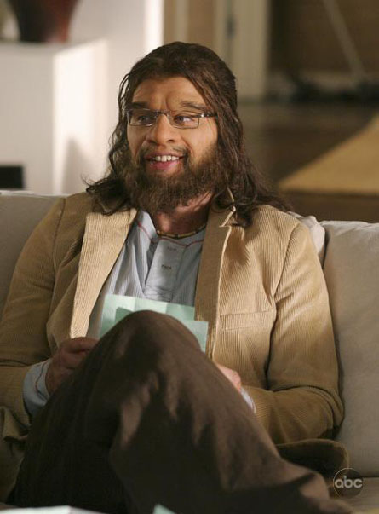
HOMO-ERECTUS APPEARS
1,500,000. Around 1,500,000, the first humans appeared on the Earth. The scientific name given to them was Homo-Erectus but today they are just simply referred to as cavemen.

Slide 3
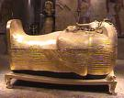
TUT WILL KICK YOUR BUTT
The most famous of all the kings found in the Valley of the Kings was Tutankhamen, also known as King Tut. He died in mid-January, 1343 B.C. It is thought that he was murdered by an official because his skull was bashed in and only a person of great importance could get near enough to harm him.

Slide 4
CAN I HAVE FRIES WITH THAT MC-CAESAR?
During 44 B.C., one of the best known tragedies to man took place. That was the assassination of the ruler of Rome Julius Caesar.

Slide 5
ATHENS
Athens, Greece had the honor of hosting the first ever Olympic games. Little did they know that they were the first to host an event that would take the world by storm.

Slide 6
Napoleon = EPIC FAIL
http://www.youtube.com/watch?v=ZpUz5zXywhY
In 1815, Napoleon Bonaparte was defeated at Waterloo.

Slide 7
FRENCH FRY REVOLUTION
The French Revolution began a new age in European political life. The old political order in France was destroyed. The new order was based on individual rights, representative institutions, and loyalty to the nation rather than the monarch. This was a great turning point in the history of France.

Slide 8
AMERICAN REVOLUTION
In 1776, American colonists took steps to win their freedom from Great Britain. The American Revolution began in 1775, but in 1776, the major step was taken with the signing of the Declaration of Independence.

Slide 9
MOSQUE, MORE LIKE MOSQUASTLE
In 852, the Tower Mosque in Iraq was completed.

Slide 10
BLACK DEATH
In 1347, the Black Death swept through Europe and wiped out half of their population. This is for sure the most devastating event that has ever hit Europe

Slide 11
FIRST CHURCH OF ENGLAND
Henry VIII was a significant figure in the history of the English monarchy. Although in the great part of his reign he brutally suppressed the Protestant reformation of the church. Although some claim he became a Protestant on his death-bed, he advocated Catholic ceremony and doctrine throughout his life

Slide 12
NO, NINA, PINTA, AND SANTA MARIA WERE NOT CHRISTOPHER COLUMBUS’ GIRLFRIENDS
In 1492, Christopher Columbus sailed the not yet known seven seas to discover America.

Slide 13
THIRTY YEARS WAR
The Thirty Years War began in Germany in 1618. Although not sure how long it lasted.

Slide 14
TOKUGAWA (FINGERKUGAWA)
In Japan, Tokugawa’s rule in Japan began. This began the era of the “Great Peace”

Slide 15
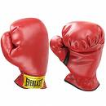
Galileo versus Catholic Church
In 1633, the Catholic Church condemned Galileo and his teachings because they thought they went against the Bible.

Slide 16
SOCRATES
http://www.youtube.com/watch?v=2EwaFkPMdlY

Slide 17
ROBERT FULTON WAS THAT GUY
In 1807, Robert Fulton invented the first paddle-wheel steamboat.

Slide 18
CAN YOU HERE ME NOW?
Alexander Graham Bell's father, grandfather, and brother had all been associated with work on elocution and speech, and both his mother and wife were deaf, greatly influencing Bell's life's work. His research on hearing and speech further led him to experiment with hearing devices which eventually led to bell inventing the telephone in 1876 and soon being awarded the first United States patent.

Slide 19
BEHIND THE BACK ATTACK
In 1915, a German submarine violated their agreements not to attack and did it anyway by sinking the American owned ship Lusitania.

Slide 20
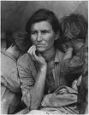
THE GREAT DEPRESSION
This is a photo by Margaret Shaut describing the pain and suffering families went through during the Great Depression.
On October 29, 1929, The Great Depression swept across not only the United States but the entire world. When the stock market crashed that day in 1929 (which is now known as Black Tuesday), the whole world was affected by it. It caused many people pain and suffering and thankfully ending about five or ten years later depending on where you were from.

Slide 21
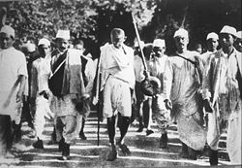
GHANDI AND HIS CHOLESTEROL
In 1939, Mahatmas Gandhi led a series of protests boycotting British laws in India. One of the unnecessary laws passed by the British was that they tried taxing the people of colonial India to grow salt. This led to the most famous of his protests which was known as the Salt March. This was a group of people, led by Mahatmas Gandhi, each collected a grain of salt and marched to Dandi and dropped a grain of salt in the water.

Slide 22
HERE COMES THE BOOM
In 1945, the most devastating event that has ever hit Japan hit. That was the atomic bombing courtesy of the United States. The United States knew that Japan was holding weapons of mass destruction and the only way to make sure Japan and Germany (who was also involved) couldn’t hurt anybody was to wipe them out.

Slide 23
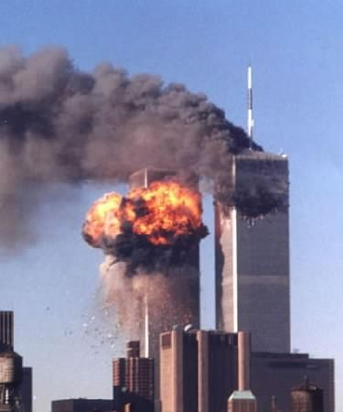
911
On September 11, 2001, Five Islamic terrorists decided to bomb the World Trade Centers and the Pentagon. The bombing took place because the terrorists viewed the World Trade Centers and the Pentagon as a symbol of capitalism for the United States.

Slide 24
Tiananmen Square
The Tiananmen Square protests of 1989 culminating in the Tiananmen Square Massacre were a series of demonstrations in and near Tiananmen Square in Beijing. Led mainly by students and intellectuals, the protests occurred in a year that saw the collapse of a number of communist governments around the world

Slide 25
THIS POWERPOINT HAS BEEN BROUGHT IN PART TO YOU BY

Slide 26
THAT GUY

Slide 27
MOUNTAIN DEW MOUTH

Slide 28
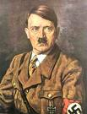
HITLER

Slide 29
SOURCES
WEBSITES
www.wikipedia.org
www.google.com/images
www.youtube.com
BOOKS
Glencoe World History Text Book

Slide 30
THE END
http://www.youtube.com/watch?v=Yu_moia-oVI
By: Brennan Alderman

